Slide 1
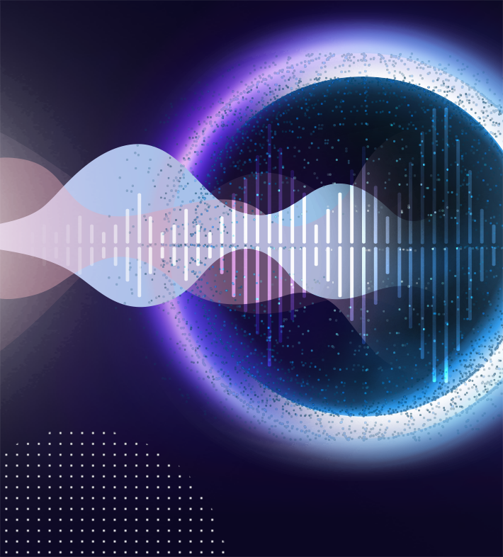
Introduction to AI
What is Artificial Intelligence?
It is the field of study in Computer Science that develops and studies intelligent machines.
Notes:
Who can give us a definition of AI? Or perhaps some examples of AI in action.

Slide 2

What is
Machine Learning?
Machine learning is an umbrella term for solving problems through feeding computer algorithms with a lot of data and letting the machines “discover” patterns within the data without needing to be explicitly told what to do by any human-developed instructions.
Notes:
Who can give us a definition of ML? Or perhaps some examples of ML in action.

Slide 3

What is
Deep Learning?
Deep Learning is a subset of Machine Learning that uses deep neural networks with multiple layers to automatically learn complex patterns from data, making it particularly effective for tasks like image and speech recognition. It has revolutionised AI by achieving remarkable results in various applications thanks to its ability to extract high-level features and representations from large datasets.
Notes:
Who can give us a definition of DL? Or perhaps some examples of DL in action.

Slide 4
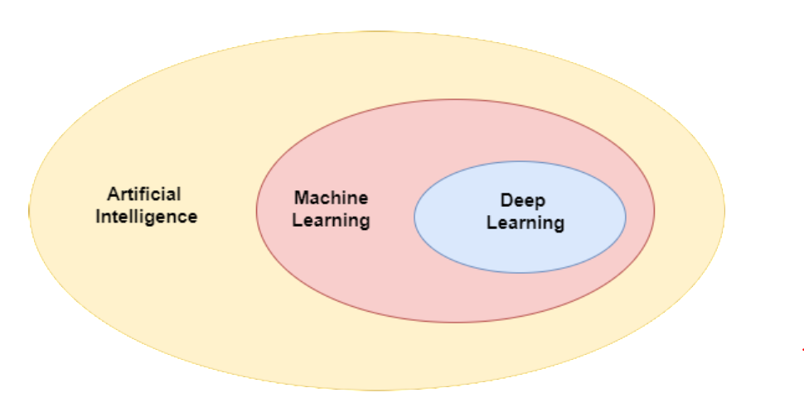
Comparison of Machine Learning, Deep Learning, & Artificial Intelligence
Notes:
[before showing the visualisation]
So then, what is the difference between the three terms we have defined? Are they the same thing?
Are they different things?
If they are different, what are the differences?
[after slide]
This is the hierarchy of the fields. Artificial Intelligence is the high-level field, and then Machine learning is one field in AI where the use of large amounts of data is how machines learn. And then within ML, DL is a field where use of deep neural networks is the algorithm used too learn. So not all ML is DL. But all DL is ML. And then within AI, there are other fields besides ML, and we shall define some of these as we go along.

Slide 5

What is
Data Science?
Data Science is the field of study that combines domain expertise, programming skills,
and knowledge of Mathematics & Statistics to extract meaningful insights from Data.
Notes:
Who can give us a definition of Data Science? Or perhaps some examples of DS in action.
Defn Source: https://www.datarobot.com/wiki/data-science/
(has visualisation)

Slide 6

So What is the difference between Data Science & Machine Learning?
While Data Science and Machine Learning are related, they are very different fields.
In a nutshell, Data Science brings structure to Big Data.
Machine Learning focuses on learning from the Data itself.
Notes:
How are DS and ML related? Are they the same thing? If they are different, what makes them different?
[read points from slide]
Defn source: https://www.ibm.com/blog/data-science-vs-machine-learning-whats-the-difference/

Slide 7
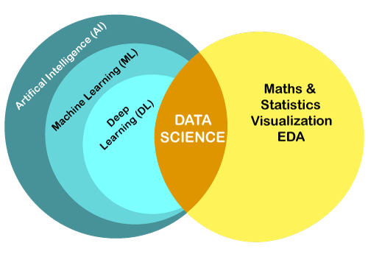
Notes:
Sometimes we will find that the terms ML, DS, DL and AI are used interchangeably.
They are related, and there is some overlap, but it is important to keep in mind that there are aspects of each that are individual to them.
This image tries to visualize this overlap.
AI techniques may be used in DS.
In additional, a data scientist is expected to have Math, statistics and visualisation skills. They need to be able to carry out analyses and then present findings in a manner than everyone can understand.
Then EDA stands for exploratory data analysis. Which still speaks to their need to understand the nuances and contexts within data.
This need is less for someone working in ML/DL, because in these fields, we want the algorithms/models to do most of the work of pattern discovery in data.
This is something they can do well, if a large amount of data is available.

Slide 8
What is Supervised Learning?
Supervised Learning (also known as Supervised Machine Learning), is a subcategory of Machine Learning and Artificial Intelligence.
It is defined by its usage of labeled datasets to train algorithms that to classify data or predict outcomes accurately).
Notes:
Can anyone define supervised learning?
Source: https://www.ibm.com/topics/supervised-learning

Slide 9
What is Unsupervised Learning?
Unsupervised Learning (also known as Unsupervised Machine Learning), uses Machine Learning algorithms to analyze and cluster unlabeled datasets.
These algorithms discover hidden patterns or data groupings without the need for human intervention.
Notes:
What about unsupervised learning, can anyone define this term?
Source: https://www.ibm.com/topics/unsupervised-learning

Slide 10
What is Semi-supervised Learning (SSL)?
Semi-supervised Learning (SSL) is a Machine Learning technique that uses a small portion of labeled data and lots of unlabeled data to train a predictive model.
Notes:
Anyone have any idea what semi-supervised learning is?
Source: https://www.altexsoft.com/blog/semi-supervised-learning/

Slide 11
What is Reinforced Learning?
Reinforced Learning is a Machine Learning paradigm that is similar to supervised learning, but the algorithm isn’t trained using sample data.
This model learns as it goes by using trial and error. A sequence of successful outcomes will be reinforced to develop the best recommendation or policy for a given problem.
Notes:
Source: https://www.ibm.com/topics/machine-learning

Slide 12

What is the difference between an Algorithm and a Model?
Machine Learning Algorithms are procedures that run on datasets to recognise patterns and rules.
Machine Learning Models are the output of the algorithm. Models act like a program that can be run on data to make predictions.
Notes:
Now let’s talk about algorithms and models.
These two terms are normally used interchangeably.
Are they the same thing or are they different things?
Source: https://www.techopedia.com/machine-learning-algorithm-or-machine-learning-model/7/34855

Slide 13
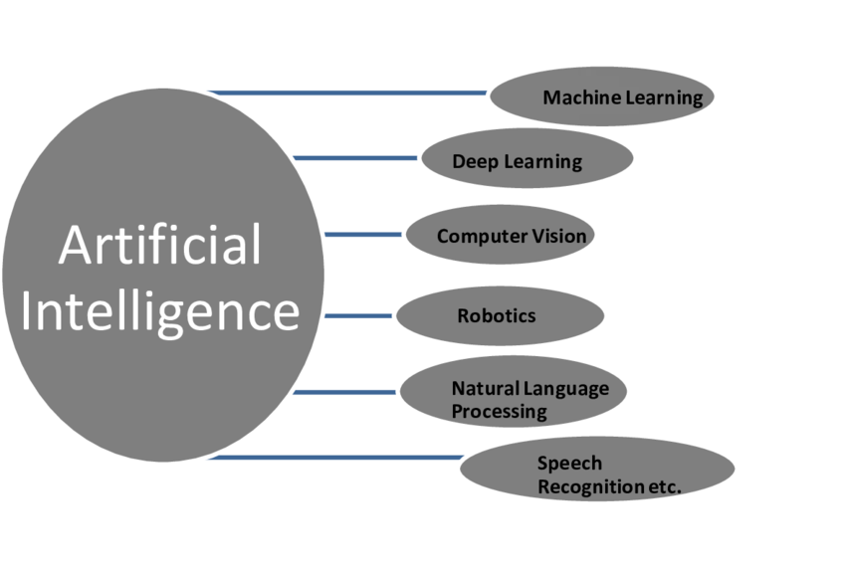
The Artificial Intelligence Landscape
Notes:
I want to zoom out again, back to the bigger picture. Remember we are getting acquainted with concepts within the filed of AI.
Now, the methods wee have just defined, are ways of learning that can probably be used in each of these domains.
I can do machine learning or NLP that makes use of supervised learning techniques, which just implies that my data had labels.
Or I can use SSL in speech recognition, if I have only a small amount of transcribed data and a whole lot of untranscribed data.
So in zooming out, let’s look at some of the other fields within AI that we have not yet touched on.
Do any of these look familiar to you? Do you have any examples of applications in some of these areas?
We will process to define some of these terms.
—
Image source: https://www.researchgate.net/figure/Sub-fields-of-Artificial-Intelligence_fig1_348976332

Slide 14

What is
Computer Vision?
Computer Vision is a field of Artificial Intelligence (AI) that enables computers and systems to derive meaningful information from digital images, videos and other visual inputs - and take actions or make recommendations based on that information.
Notes:
What are some applications of computer vision that you have seen?
Source: https://www.ibm.com/topics/computer-vision

Slide 15
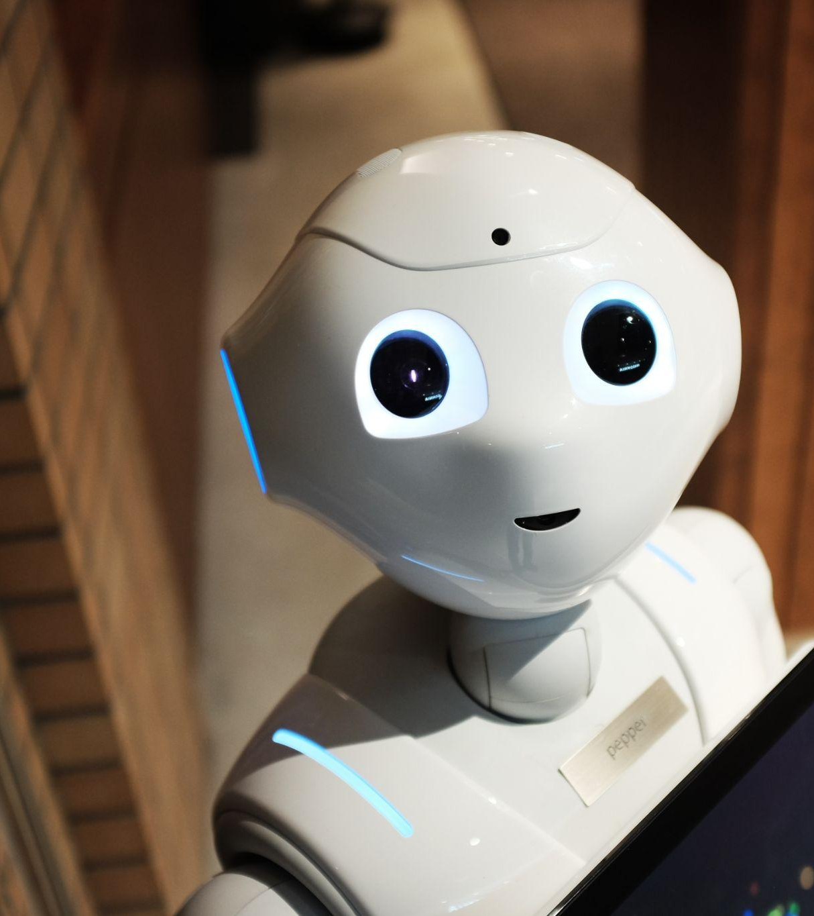
What is Robotics?
Robotics is an interdisciplinary branch of Electronics and Communication, Computer Science, and Engineering.
Robotics involves the design, construction, operation, and use of robots. The goal of robotics is to design machines that can help and assist humans.
Notes:
What is robotics?
[take some responses from the audience, then define on the slide]
I see the media refer to robots as AI, and while this is partly true, it is important to recognise that robotics has the hardware elements, which are largely engineering, and then the software that is governing these robots, is where the AI components lie.
Source: https://en.wikipedia.org/wiki/Robotics

Slide 16
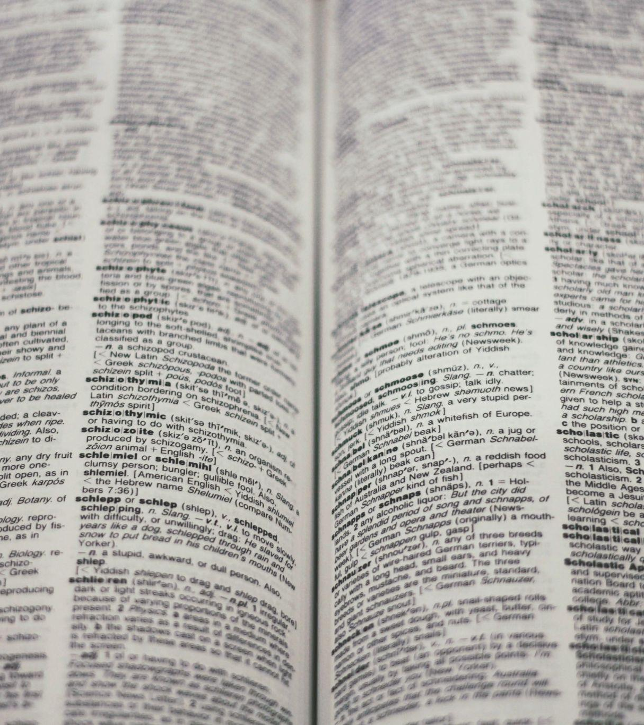
What is Natural Language Processing (NLP)?
Natural Language Processing (NLP) is a subfield of Artificial Intelligence that deals with the interaction between computers and humans in natural language.
It involves the use of computational techniques to process and analyze Natural Language Data, such as text and speech, with the goal of understanding the meaning behind the language.
Notes:
What is NLP?
[take Qns from the audience then define on slide]
We’ll now be zooming into some of the sub-fields within NLP.
Since the hackathon today falls within NLP, we thought it would be a good idea to get people knowledgeable about some of the other tasks that exist as well.

Slide 17
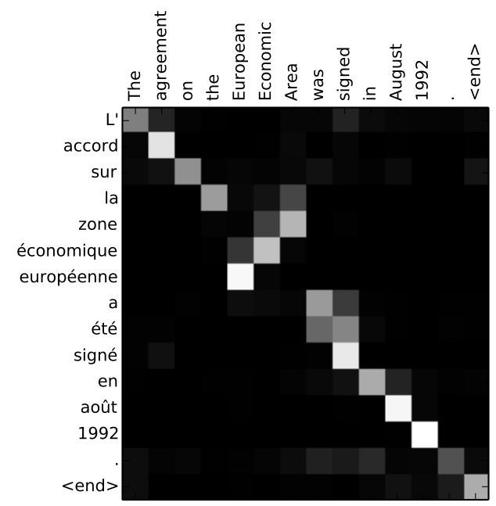
What is Machine Translation?
Machine translation is the use of either rule-based or probabilistic machine learning approaches to translation of text or speech from one language to another
Notes:
What is MT? Do you have any examples of where MT is used?
Source: https://en.wikipedia.org/wiki/Machine_translation

Slide 18
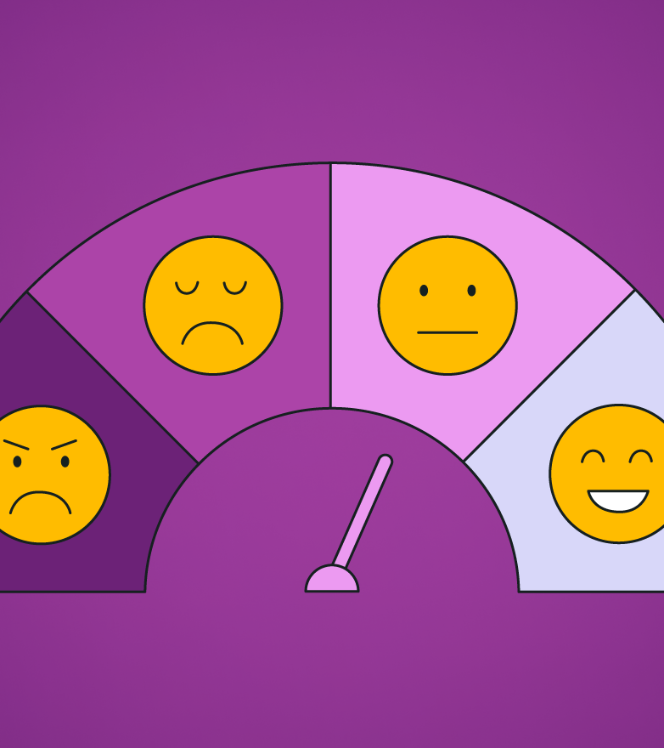
What is Sentiment Analysis?
Sentiment Analysis is the process of analyzing digital text to determine if the emotional tone of the message is positive, negative, or neutral.
Notes:
What is Sentiment Analysis? Do you have any examples of where it is used?
Source: https://aws.amazon.com/what-is/sentiment-analysis/

Slide 19
Named Entity Recognition (NER)
Named Entity Recognition (NER) involves the identification of key information in text and classification into a set of predefined categories.
also known as (named) entity identification, entity chunking, and entity extraction
An entity is basically the thing that is consistently talked about or referred to in the text. Some of these categories are:
People
Organisations
Places
Notes:
What is NER? Do you have any examples of where it is used?
Source: https://www.geeksforgeeks.org/named-entity-recognition/

Slide 20
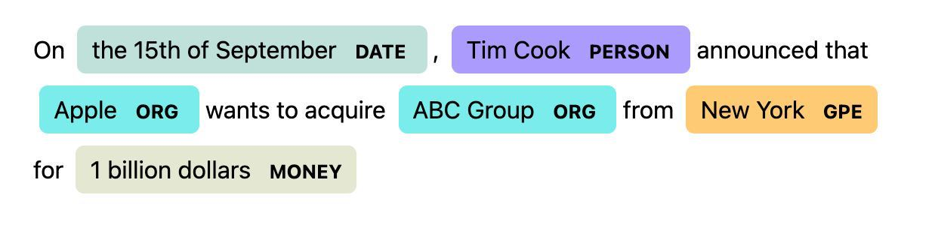
EXAMPLE

Slide 21
Question Answering (QA)
Question Answering (QA) is a Computer Science that is concerned with building systems that automatically answer questions that are posed by humans in a natural language.
Question Answering models can retrieve the answer to a question from a given text, which is useful for searching for an answer in a document.
Notes:
What is QA? Do you have any examples of where it is used?
Source: https://en.wikipedia.org/wiki/Question_answering

Slide 22

What is Speech to Text (STT)/Automatic Speech Recognition (ASR)?
ASR is the technology that allows human beings to use their voices to speak with a computer interface, in a way that, in its most sophisticated variations, resembles normal human conversation.
It is also known as Automatic Transcription, i.e. these tools turn speech/audio into text.
Notes:
What is STT?
Source: https://usabilitygeek.com/automatic-speech-recognition-asr-software-an-introduction/

Slide 23
Text to Speech/Speech Synthesis
Speech Synthesis is the artificial production of human speech.
A Text-To-Speech (TTS) system converts normal language text into speech.
Notes:
What is TTS?
[take defns from audience, define]
In some ways it is the opposite of STT.
And a very necessary component of a voice application.
STT makes it possible for users of your application to speak to the application/phone.
TTS makes it possible for the application to respond/communicate back, also via a voice component.

